Slide 1

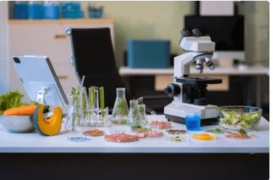
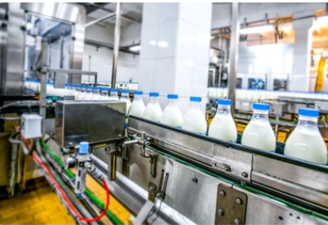
Training program description sheet
الجمهوربة الجزائرية الديمقراطيةالشعبية
République Algérienne Démocratique Et Populaire
Ministry of Higher Education and Scientific Research
University of Blida 1
Faculty of Natural and Life Sciences
Department of Food Sciences
وزارة التعليم العالي و البحث العلمي
جامعة البليدة- 1
كلية علوم الطبيعة و الحياة
قسم علوم التغذية
Bachelor’s degree in Food Technology and Quality Control
ليسانس في تكنولوجيا الأغذية ومراقبة الجودة
Level: Academic Bachelor’s Degree
Field: Natural and Life Sciences
Stream: Food Sciences
Specialty: Food Technology and Quality Control

Slide 2
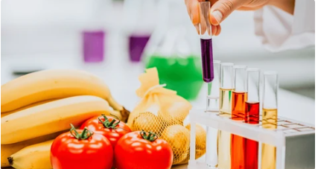
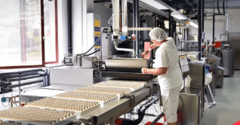
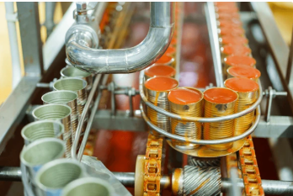
Decree No. 1602 of October 6, 2016, amending the annex to Decree No. 751 of August 5, 2015, concerning the compliance of accredited Bachelor’s programs at the University of Blida 1 in the field of “Natural and Life Sciences.”
Objectives of the program:
This program aims to meet the needs of the agri-food sector surrounding the university. It seeks to train bachelor’s graduates, under optimal conditions, who are proficient in development and research in the following areas:
      Processing
      Packaging
      Product development
      Operation and management of
        processing units
            .

Slide 3
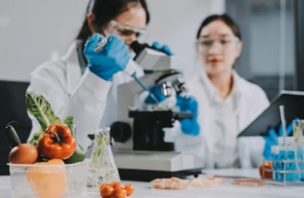


Profiles and targeted competencies:
✓ Evaluate the quality of raw materials by reference to specifications and requirements (specifications sheets and standards)
✓ Monitor the manufacturing process, detect anomalies, and assess product quality during and at the end of production
✓ Perform routine and specific analyses (microbiology, physico-chemistry, product quality control)
✓ Contribute to the company’s “Quality” approach and be able to assess good hygiene practices and the implementation of HACCP procedures
✓ Master storage and preservation conditions
✓ Analyze consumer expectations
Regional and national employability opportunities
The training in Food Technology aims to provide the job market with qualified professionals who are directly operational in processing units, valorization units of agro-food industry (AFI) by-products, agriculture sectors, as well as packaging and export organizations.
Agro-food industry units
Food product quality control laboratories (public or private)
Quality control inspection services

Slide 4


Training curriculum
First-year common core in Natural and Life Sciences
Second-year common core in Food Sciences
Semester 1:
General and Organic Chemistry
Cell Biology
Geology
Statistical Mathematics
Communication and Expression Techniques 1 (in French)
Study Methods and Terminology 1
Universal History of Biological Sciences
Semester 2:
Thermodynamics and Solution Chemistry
Plant Biology
Animal Biology
Physics
Communication and Expression Techniques 2 (in English)
Life Sciences and Socio-Economic Impacts
Study Methods and Terminology 2
Semester 3:
Plant Physiology
Food and Food Systems
Biochemistry
Genetics
Communication and Expression Techniques (in English)
Biophysics
Environment and Sustainable Development
University Ethics and Deontology
Semester 4:
Animal Physiology
Microbiology
Food and Fundamentals of Food Technology
Applied Immunology
Biostatistics
Plants and Environment
Computer Tools

Slide 5

Training curriculum
Third-year Bachelor’s degree in Agro-Food Technology and Quality Control
Semester 5
Food Microbiology
Food Biochemistry
Agro-Food Industry Technology 1
Food Hygiene and Safety
Process Engineering
Sensory Analysis of Food Products
Food Storage and Preservation
Introduction to Free and Open-Source Software
Management and Marketing
Semester 6
Food Toxicology
Analytical Techniques
Agro-Food Industry Technology 2
Scientific Approach to Writing a Scientific Report
Analysis of Food Materials
Introduction to Computer Programming
Technical English
Communication and Expression Techniques

Slide 6
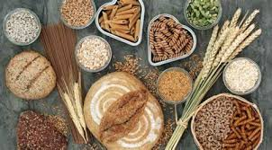
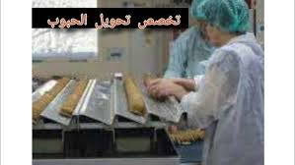
الجمهوربة الجزائرية الديمقراطيةالشعبية
République Algérienne Démocratique Et Populaire
Ministry of Higher Education and Scientific Research
University of Blida 1
Faculty of Natural and Life Sciences
Department of Food Sciences
وزارة التعليم العالي و البحث العلمي
جامعة البليدة- 1
كلية علوم الطبيعة و الحياة
قسم علوم التغذية
Training program description sheet
Professional Bachelor’s Degree in Cereal Processing and Derived Products
ليسانس مهني في تكنولوجيا الحبوب والمنتجات المشتقة
Level: Academic Bachelor’s Degree
Field: Natural and Life Sciences
Stream: Food Sciences
Specialty:Cereal Processing and Derived Products

Slide 7
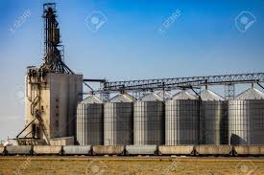
Decree No. 1602 of October 6, 2016, amending the annex to Decree No. 751 of August 5, 2015, concerning the compliance of accredited Bachelor’s programs at the University of Blida 1 in the field of “Natural and Life Sciences.”
Objectives of the program:
This program aims to meet the needs of the cereal and agri-food sector surrounding the university. It seeks to train bachelor’s graduates, under optimal conditions, who are proficient in development, processing, and research in the following areas:
Cereal processing technologies Processing of cereal-based products (flour, semolina, pasta, etc.)
Development and innovation of cereal-derived
productsQuality control and food safety of cereals and their derivativesOperation and management of cereal processing

Slide 8
Training curriculum
First-year common core in Natural and Life Sciences
Second-year common core in Food Sciences
Semester 1:
General and Organic Chemistry
Cell Biology
Geology
Statistical Mathematics
Communication and Expression Techniques 1 (in French)
Study Methods and Terminology 1
Universal History of Biological Sciences
Semester 2:
Thermodynamics and Solution Chemistry
Plant Biology
Animal Biology
Physics
Communication and Expression Techniques 2 (in English)
Life Sciences and Socio-Economic Impacts
Study Methods and Terminology 2
Semester 3:
Plant Physiology
Food and Food Systems
Biochemistry
Genetics
Communication and Expression Techniques (in English)
Biophysics
Environment and Sustainable Development
University Ethics and Deontology
Semester 4:
Animal Physiology
Microbiology
Food and Fundamentals of Food Technology
Applied Immunology
Biostatistics
Plants and Environment
Computer Tools

Slide 9
Training curriculum
Third-year Bachelor’s degree in in Cereal Processing and Derived Products
Semester 5
English
• Storage and Conditioning
• Cereal Cultivation / Quality Improvement
• Quality, Standardization and Regulation
• Computer Science
• Technical Drawing
• Quality Control (Grading)
• Grain Biochemistry
• Applied Microbiology
• Mathematics Analysis
• Applied Physical Chemistry
• Electrotechnics
• Introductory Internship
Semester 6
Cereal Processing Technology
• Flour and Semolina Technology
• Bakery and Pasta Technology
• Quality Control and Food Safety
• Food Packaging
• Industrial Process Management
• Applied Microbiology (Advanced)
• Food Analysis Techniques
• Professional Internship

Slide 10
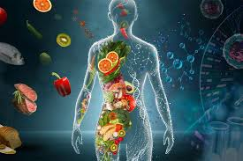
الجمهوربة الجزائرية الديمقراطيةالشعبية
République Algérienne Démocratique Et Populaire
Ministry of Higher Education and Scientific Research
University of Blida 1
Faculty of Natural and Life Sciences
Department of Food Sciences
وزارة التعليم العالي و البحث العلمي
جامعة البليدة- 1
كلية علوم الطبيعة و الحياة
قسم علوم التغذية
Training program description sheet
Bachelor’s Degree in Food, Nutrition and Diseases
التغذية والأمراض ليسانس
Level: Academic Bachelor’s Degree
Field: Natural and Life Sciences
Stream: Food Sciences
Specialty: Food, Nutrition and Diseases

Slide 11

Decree No. 1602 of October 6, 2016, amending the annex to Decree No. 751 of August 5, 2015, concerning the compliance of accredited Bachelor’s programs at the University of Blida 1 in the field of “Natural and Life Sciences.”
Objectives of the program:
• Understand the link between nutrition and diseases
• Master food composition and quality
• Apply food safety and hygiene principles
• Develop balanced and functional foods
• Promote public health and dietary awareness

Slide 12
Training curriculum
First-year common core in Natural and Life Sciences
Second-year common core in Food Sciences
Semester 1:
General and Organic Chemistry
Cell Biology
Geology
Statistical Mathematics
Communication and Expression Techniques 1 (in French)
Study Methods and Terminology 1
Universal History of Biological Sciences
Semester 2:
Thermodynamics and Solution Chemistry
Plant Biology
Animal Biology
Physics
Communication and Expression Techniques 2 (in English)
Life Sciences and Socio-Economic Impacts
Study Methods and Terminology 2
Semester 3:
Plant Physiology
Food and Food Systems
Biochemistry
Genetics
Communication and Expression Techniques (in English)
Biophysics
Environment and Sustainable Development
University Ethics and Deontology
Semester 4:
Animal Physiology
Microbiology
Food and Fundamentals of Food Technology
Applied Immunology
Biostatistics
Plants and Environment
Computer Tools

Slide 13
Training curriculum
Third-year Bachelor’s degree inFood, Nutrition and Diseases
Semester 5
Dietetics and Food Composition
Nutrition and Pathologies
Digestive Physiology Food
Analysis Food Biochemistry and Regulation
Biostatistics Free and Open Source Software
Scientific English
Semester 6
Food Quality Management
Toxicology and Microbiological Food Safety
Fundamentals of Nutritional Epidemiology
Agri-food Sectors and Processing TechnologiesFood
Preservation ProcessesFood Packaging:
Regulations and Environment
Nutritional Communication Entrepreneurship

